Slide 1
Seattle Car Accident Analysis
Done by- M S Gokul

Slide 2
The presentation is about finding the probability of a vehicle will meet an accident under the given features at a particular area at a particular time given

Slide 3
Problem Introduction
•The case study is predicting the severity of the accident. The Outcome of the case study is mainly targeted for Traffic departments, Travellers & Tourist, local residents and others those who use the roadway service for the day to day work.

Slide 4
Data Set
All collisions provided by SPD and recorded by Traffic Records. Description This includes all types of collisions. Collisions will display at the intersection or mid-block of a segment. Timeframe: 2004 to Present.
Rows 194673
Columns 38

Slide 5
Methodology
The supervised classification algorithms used are:
KNN
Support Vector Machine
Decision Tree
Random Forest

Slide 6
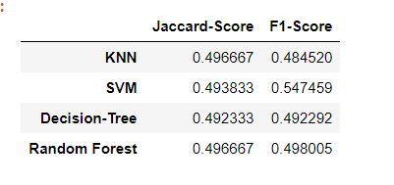
Results

Slide 7
Conclusion
From the scores obtained I have inferred that Random Forest will be the best among the classifier algorithms by providing an accuracy of ~50%

Slide 8
Thank You

